Slide 1
INFDEV026A - Algoritmiek Week 3
G. Costantini, F. Di Giacomo, G. Maggiore
costg@hr.nl, giacf@hr.nl, maggg@hr.nl – Office H4.204

Slide 2
Practical examination and oral check
Continue with the first exercise of the assignment!
Oral check… how does it work?
We will remove a few lines of code from each of the exercises
You will be asked to make your program work again

Slide 3
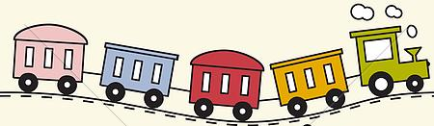



Today
LIST
Why is my code slow?
Empirical and complexity analysis
How do I order my data?
Sorting algorithms
How do I structure my data?
Linear, tabular, recursive data structures
How do I represent relationship networks?
Graphs
QUEUE
STACK
HASH TABLE

Slide 4
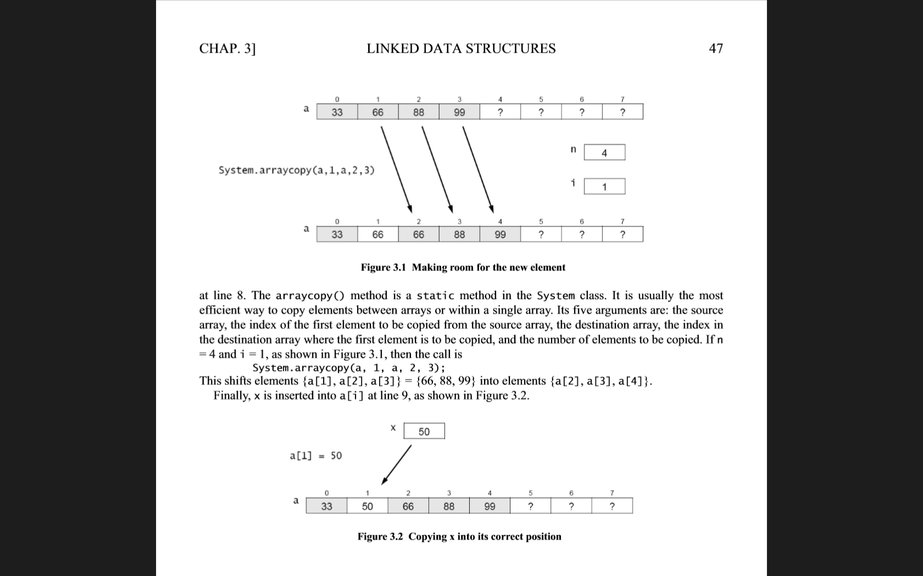
Why arrays are not enough?
Arrays are good for…
Sequential access (cache)
But not for…
Algorithmic stuff on dynamic data
Why?
In an unsorted array, searching is slow
Linear search instead of binary search
But to maintain an array sorted, inserting & deleting elements is slow
Need to shift all elements bigger than the one to insert/delete
Notes:
Unsorted sequences
Static data (does not change much)

Slide 5
Linked lists

Slide 6
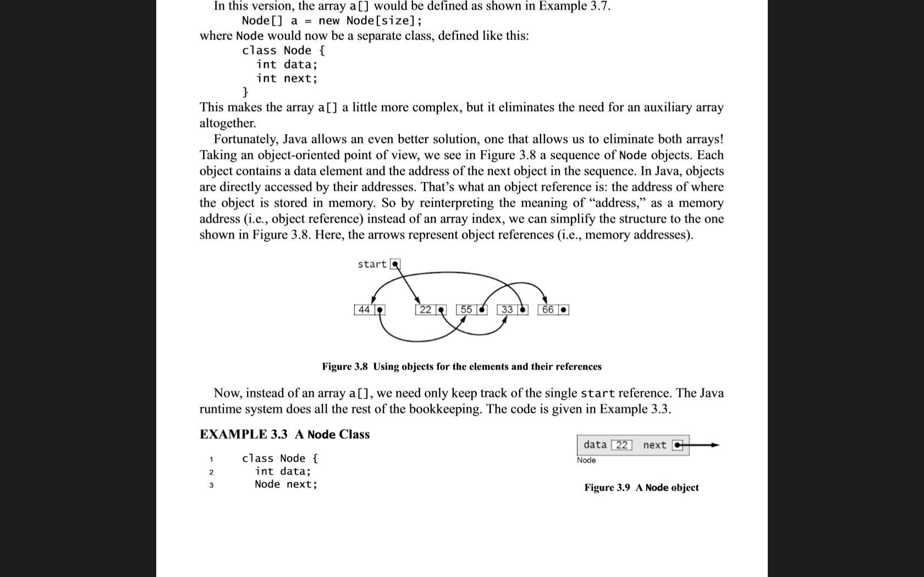
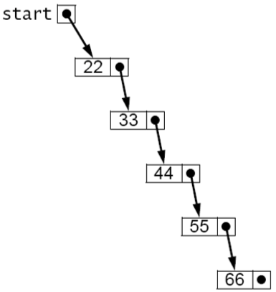
Linked list
Simple and flexible representation
Objects are arranged in linear order
Order is maintained through the use of references inside elements
Each element (node) of a list is made by
Its value
A reference to the next element of the list
A list is then defined by
The starting element
All other elements can be reached from there
Notes:
Possibly show an implementation of lists in C# → http://stackoverflow.com/questions/3823848/creating-a-very-simple-linked-list

Slide 7
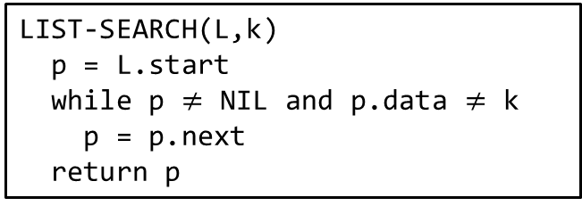
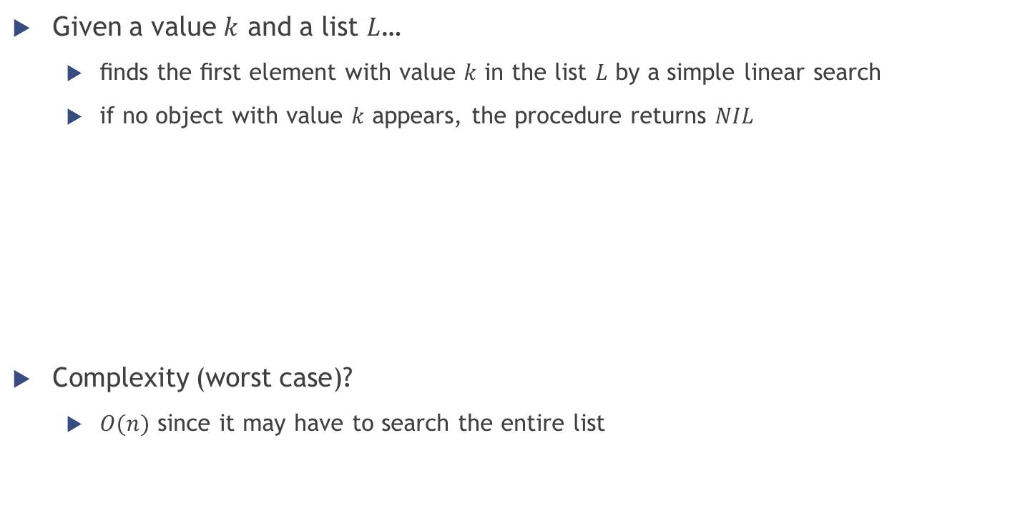
Linked list operations: SEARCH
Given a value $k$ and a list $L$…
ﬁnds the ﬁrst element with value $k$ in the list $L$ by a simple linear search
if no object with value $k$ appears, the procedure returns $NIL$
Complexity (worst case)?
$O(n)$ since it may have to search the entire list
LIST-SEARCH(L,k)
p = L.start
while p $≠$ NIL and p.data $≠$ k
p = p.next
return p

Slide 8
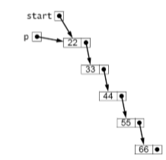
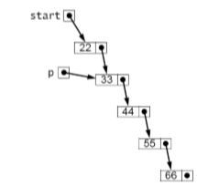
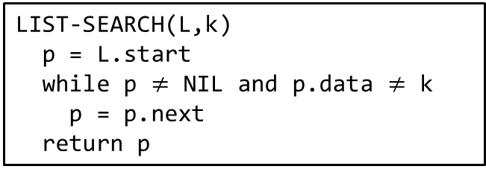

Linked list operations: SEARCH
LIST-SEARCH(L,k)
p = L.start
while p $≠$ NIL and p.data $≠$ k
p = p.next
return p
Example: looking for $k=44$
First iteration: $p$ is the start node (containing 22)
Second iteration: $p$ is the second node (containing 33)
Third (and last) iteration: $p$ is the third node (containing $k=$ 44)

Slide 9
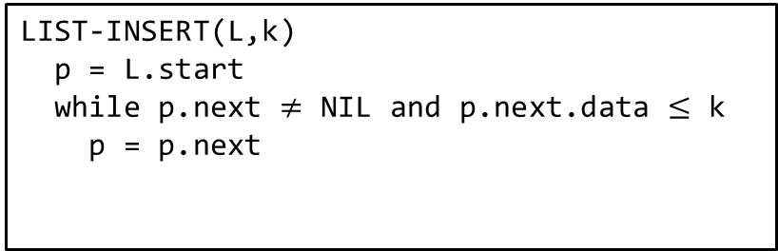

Linked list operations: INSERT
Given a value $k$ and a (sorted) list $L$…
ﬁnds the right position in the list for $k$ through a simple linear search
LIST-INSERT(L,k)
p = L.start
while p.next $≠$ NIL and p.next.data $≤$ k
p = p.next
looking for the position

Slide 10
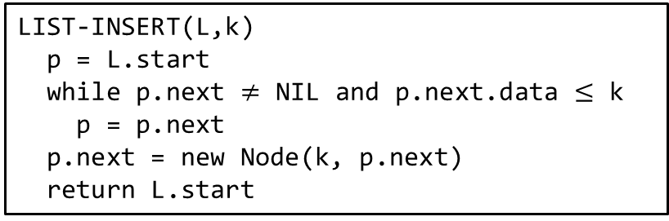

Linked list operations: INSERT
Given a value $k$ and a (sorted) list $L$…
ﬁnds the right position in the list for $k$ through a simple linear search
inserts a new element with value $k$ in such position
LIST-INSERT(L,k)
p = L.start
while p.next $≠$ NIL and p.next.data $≤$ k
p = p.next
p.next = new Node(k, p.next)
return L.start
looking for the position
insertion of the new node

Slide 11
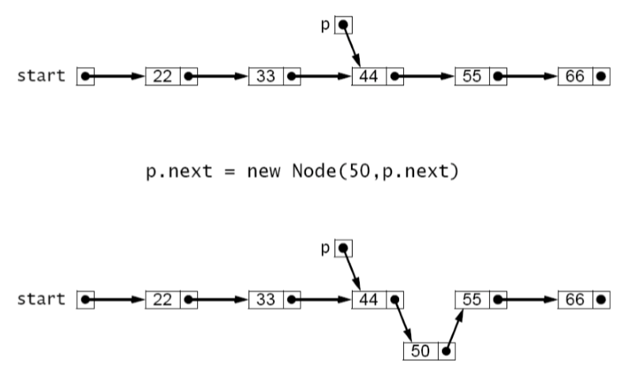

Linked list operations: INSERT
Example: inserting 50
LIST-INSERT(L,k)
p = L.start
while p.next $≠$ NIL and p.next.data $≤$ k
p = p.next
p.next = new Node(k, p.next)
return L.start
looking for the position
insertion of the new node

Slide 12

Linked list operations: INSERT
What if we tried to insert 20 in the previous example?
LIST-INSERT(L,k)
p = L.start
while p.next $≠$ NIL and p.next.data $≤$ k
p = p.next
p.next = new Node(k, p.next)
return L.start
looking for the position
insertion of the new node

Slide 13

Linked list operations: INSERT
What if we tried to insert 20 in the previous example?
Special case: insertion AT THE FRONT of the list
If the element to insert is smaller than the starting one
LIST-INSERT(L,k)
if L.start == NIL or L.start.data $>$ k
L.start = new Node(k, L.start)
return L.start
p = L.start
while p.next $≠$ NIL and p.next.data $≤$ k
p = p.next
p.next = new Node(k, p.next)
return L.start
insertion at the front
(if needed)
looking for the position
insertion of the new node

Slide 14
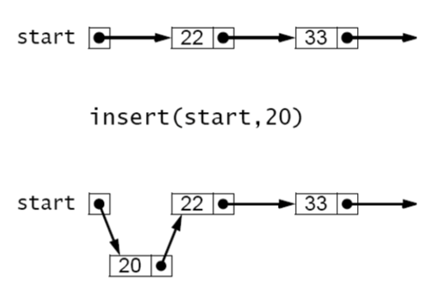

Linked list operations: INSERT
LIST-INSERT(L,k)
if L.start == NIL or L.start.data $>$ k
L.start = new Node(k, L.start)
return L.start
x = L.start
while x.next $≠$ NIL and x.next.data $≤$ k
x = x.next
x.next = new Node(k, x.next)
return L.start
insertion at the front
(if needed)
Example:
Inserting 20
looking for the position
insertion of the new node

Slide 15


Linked list operations: DELETE
Given a value $k$ and a (sorted) list $L$…
ﬁnds the first occurrence of the value $k$ in the list through a simple linear search
deletes such element (if it exists!)
LIST-DELETE(L,k)
p = L.start
while p.next $≠$ NIL and p.next.data $≤$ k
if p.next.data == k
p.next = p.next.next
return L.start
p = p.next
return L.start
looking for the position
deletion of the node

Slide 16
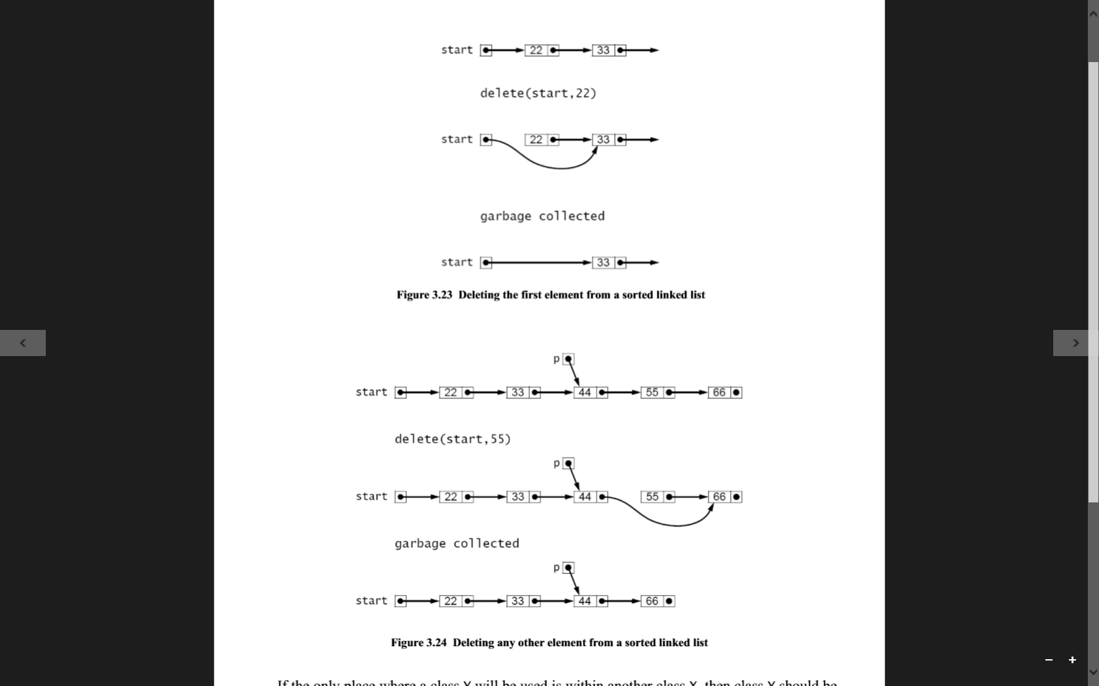

Linked list operations: DELETE
Example: deleting 55
LIST-DELETE(L,k)
p = L.start
while p.next $≠$ NIL and p.next.data $≤$ k
if p.next.data == k
p.next = p.next.next
return L.start
p = p.next
return L.start

Slide 17

Linked list operations: DELETE
And if we wanted to delete 22?
LIST-DELETE(L,k)
x = L.start
while x.next $≠$ NIL and x.next.data $≤$ k
if x.next.data == k
x.next = x.next.next
return L.start
x = x.next
return L.start
looking for the position
deletion of the node

Slide 18

Linked list operations: DELETE
And if we wanted to delete 22?
Special case: deleting the first element of the list
LIST-DELETE(L,k)
if L.start == NIL or L.start.data $>$ k
return L.start
else if L.start.data == k
return L.start.next
x = L.start
while x.next $≠$ NIL and x.next.data $≤$ k
if x.next.data == k
x.next = x.next.next
return L.start
x = x.next
return L.start
element not in the list
deleting the first element
looking for the position
deletion of the node

Slide 19

Linked list operations: DELETE
Example: deleting 22
LIST-DELETE(L,k)
if L.start == NIL or L.start.data $>$ k
return L.start
else if L.start.data == k
return L.start.next
x = L.start
while x.next $≠$ NIL and x.next.data $≤$ k
if x.next.data == k
x.next = x.next.next
return L.start
x = x.next
return L.start

Slide 20
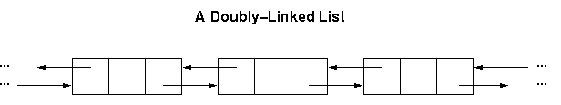
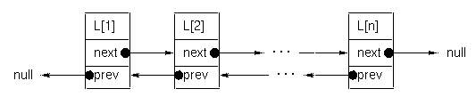
Doubly linked list
What if we want to move both forward and backward?
Add another reference to the node: the previous element in the list

Slide 21
Suggested exercise
Write the code to…
Insert a new node after/before a certain node in a doubly linked list
function insertAfter(List list, Node node, Node newNode)
function insertBefore(List list, Node node, Node newNode)
Insert a new node at the beginning of a doubly linked list
function insertBeginning(List list, Node newNode)
Delete a certain node in a doubly linked list
function remove(Lis list, Node node)
DoublyLinkedNode {
prev // A reference to the previous node
next // A reference to the next node
data // Data or a reference to data
}
DoublyLinkedList {
DoublyLinkedNode firstNode // points to first node of list
DoublyLinkedNode lastNode // points to last node of list
}

Slide 22

Stack

Slide 23

Stack – Definition
Collection implementing the LIFO protocol
LIFO = Last In First Out
Only accessible object: last one inserted
Operations allowed
Adding an element onto the top of the stack (PUSH)
Accessing the current element on the top of the stack (PEEK)
Removing the current element on the top of the stack (POP)
Notes:
The simplest application of a stack is to reverse a word. You push a given word to stack - letter by letter - and then pop letters from the stack.
Another application is an "undo" mechanism in text editors; this operation is accomplished by keeping all text changes in a stack.
Backtracking. This is a process when you need to access the most recent data element in a series of elements. Think of a labyrinth or maze - how do you find a way from an entrance to an exit? Once you reach a dead end, you must backtrack. But backtrack to where? to the previous choice point. Therefore, at each choice point you store on a stack all possible choices. Then backtracking simply means popping a next choice from the stack.
Language processing

Slide 24
Stack – Implementation
Built on top of other data structures
array, linked list, …
However, it implements always the same functionality
defined by the following interface
public interface StackInterface<AnyType>
{
public void push(AnyType e);
public AnyType pop();
public AnyType peek();
public boolean isEmpty();
}

Slide 25
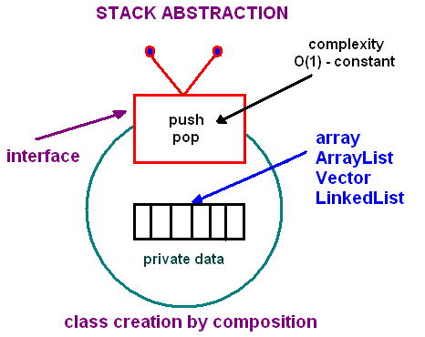
Stack – Implementation
Built on top of other data structures, but implementing always the same functionality

Slide 26
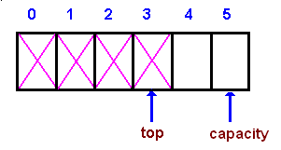
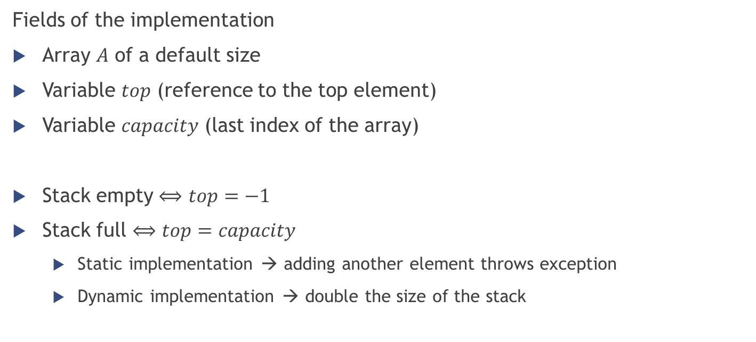
Stack – Indexed implementation
Fields of the implementation
Array $A$ of a default size
Variable $top$ (reference to the top element)
Variable $capacity$ (last index of the array)
Stack empty $⟺$ $top=−1$
Stack full $⟺$ $top=capacity$
Static implementation → adding another element throws exception
Dynamic implementation → double the size of the stack

Slide 27
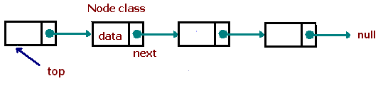
Stack – Linked implementation
Best (in efficiency) dynamic stack implementation
Be careful at the special case of empty stack
Top?
starting element of the list
Access (peek)?
Read the content of the top
Push?
Create a new node and add it at the beginning of the list
Pop?
Move the beginning of the list at the second element
Notes:
A nice example of the stack use would be the implementation of the “back” and “next” button in a browser.

Slide 28
Queue

Slide 29
Queue – Definition
Collection implementing the FIFO protocol
FIFO = First In First Out
Only accessible object: first one inserted
In the stack it’s the opposite (last one inserted)
Operations allowed
Adding an element to the back of the queue (ENQUEUE)
Accessing the current element at the front of the queue (PEEK)
Removing the current element at the front of the queue (DEQUEUE)

Slide 30
Queue – Implementation
Built on top of other data structures
array, linked list, …
However, it implements always the same functionality
defined by the following interface
interface QueueInterface‹AnyType>
{
public void enqueue(AnyType e);
public AnyType peek();
public AnyType dequeue();
public boolean isEmpty();
}

Slide 31
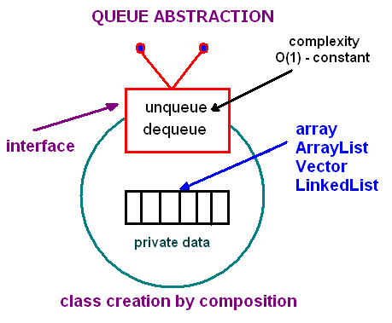
Queue – Implementation
Built on top of other data structures, but implementing always the same functionality

Slide 32
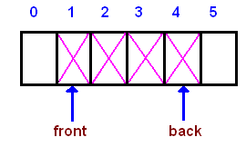
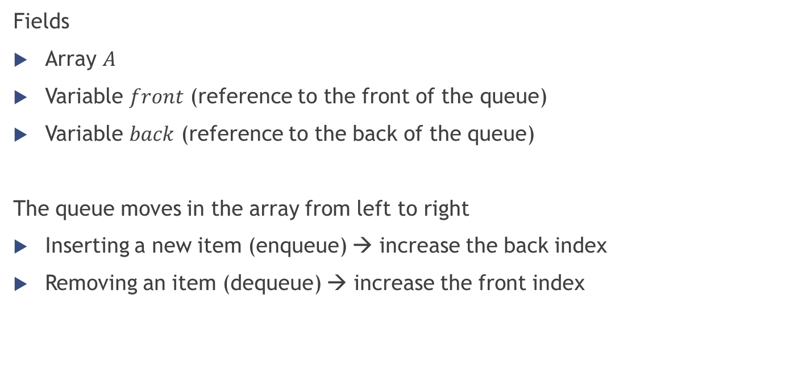
Queue – Indexed implementation
Fields
Array $A$
Variable $front$ (reference to the front of the queue)
Variable $back$ (reference to the back of the queue)
The queue moves in the array from left to right
Inserting a new item (enqueue) → increase the back index
Removing an item (dequeue) → increase the front index

Slide 33
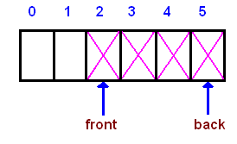
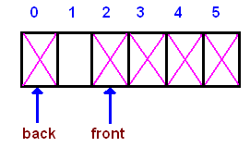
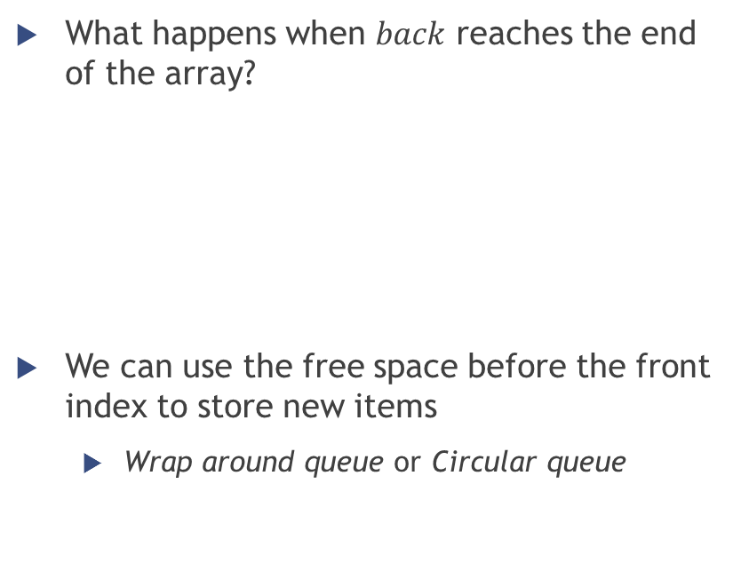
Queue – Indexed implementation
What happens when $back$ reaches the end of the array?
We can use the free space before the front index to store new items
Wrap around queue or Circular queue

Slide 34

Queue – Indexed implementation
And what happens when $back$reaches $front$?
The queue is completely full
Two choices to handle this situation (as with the stack)
Throw exception
Double the array size

Slide 35
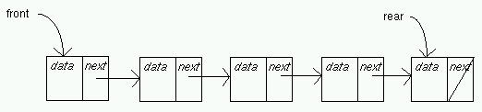
Queue – Linked implementation
Almost the same as the stack linked implementation
Here we maintain also a pointer to the last element
Front → starting element of the list
Rear → last element of the list
Enqueue
Create a new node and add it at the end of the list
Dequeue
Move the beginning of the list at the second element

Slide 36
Lists, stacks, queues in .NET
http://msdn.microsoft.com/en-US/library/ms379570(v=vs.80).aspx
http://msdn.microsoft.com/en-us/library/ms379571(v=vs.80).aspx
http://www.dotnetperls.com/list
http://www.dotnetperls.com/stack
http://www.dotnetperls.com/queue

Slide 37

Suggested exercise
Implement by yourself the generic data structures
$Queue<T>$
$Stack<T>$
$DoublyLinkedList<T>$

Slide 38

Hash table

Slide 39

Hash table - Definition
Hash table → data structure used to implement an associative array, a structure that can map keys to values
Hash table → container that allows direct access by any index type: it works like an array or vector except that the index variable need not be an integer
Also called: hash map, lookup table, associative array, dictionary
Analogy with the dictionary: index = word to look up; value indexed = dictionary definition

Slide 40
Hash table - Definition
Hash table → data structure used to implement an associative array, a structure that can map keys to values
Hash table → container that allows direct access by any index type: it works like an array or vector except that the index variable need not be an integer
Also called: hash map, lookup table, associative array, dictionary
Analogy with the dictionary: index = word to look up; value indexed = dictionary definition
Entries of a hash table are called “key-value” pairs
Key → index into the table
Value → information being looked up

Slide 41
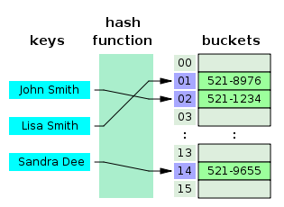
Hash table - Definition
Hashing idea → distribute the entries (key/value pairs) across an array of buckets (also called slots)
A hash function is used to compute the index in the buckets array, from which the correct value can be found
Example (phone book)

Slide 42
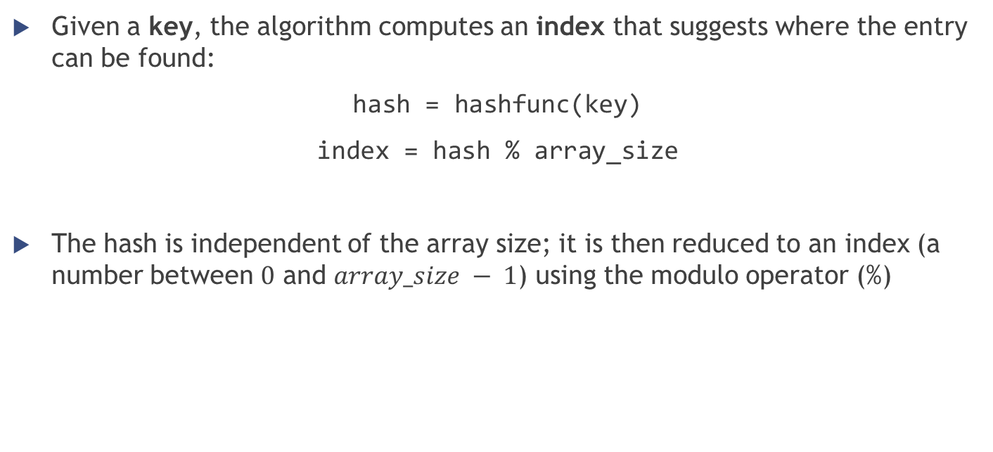
Hash table - Definition
Given a key, the algorithm computes an index that suggests where the entry can be found:
hash = hashfunc(key)
index = hash % array_size
The hash is independent of the array size; it is then reduced to an index (a number between $0$ and $array_size − 1$) using the modulo operator (%)

Slide 43
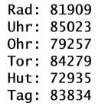
Hash table - Definition
In Java and .NET, every object is associated to a hash code (computed from the actual hard data stored in the object), accessible through the methods:
[Java] Object.hashCode()
[.NET] Object.GetHashCode()
Example: hash codes of some strings made by three characters
hash = hashfunc(key)

Slide 44


Hash table - Definition
After computing the hash code, we must compute the index inside the array
Suppose that array_size = 11
Index of Rad: 81901 % 11 = 3
Index of Uhr: 85023 % 11 = 4
Index of Ohr: 79257 % 11 = 2
Index of Tor: 84279 % 11 = 8
Index of Hut: 72935 % 11 = 5
Index of Tag: 83834 % 11 = 3 … same index as for the first string!!!
index = hash % array_size

Slide 45
Hash table – Hash function
You can also implement your own hash function
A good hash function and implementation algorithm are essential for good hash table performance, but may be difficult to achieve.
If all keys are known ahead of time, a perfect hash function can be used to create a perfect hash table that has no collisions.
Basic requirement → the function should provide a uniform distribution of hash values (to avoid collisions as much as possible)
The hash function should also avoid clustering (= the mapping of two or more keys to consecutive slots) if the open addressing method is used to resolve collisions

Slide 46
Hash table – Load factor
Load factor is a critical statistics for a hash table
Good performance depends a lot on it
$$loadFactor=\frac{\#entries}{\#buckets}$$
Entries = actual number of elements inside the table
Buckets = capacity of the table (number of total available slots)
Example: 6 elements stored in a table with 101 slots → load factor = $\frac{6}{101}=0.0594⇒5.9\%$
If the load factor is too large, the hash table becomes slow
Possible way to solve the problem: resize the table when the load factor reaches a threshold (usually $75\%$)
Notes:
A low load factor is not especially beneficial. As the load factor approaches 0, the proportion of unused areas in the hash table increases, but there is not necessarily any reduction in search cost. This results in wasted memory.
The HashMap class automatically resizes its hash table when the load factor reaches a specific threshold value. This threshold value can be set when the hash table is created, using the constructor.

Slide 47
Hash table - Collision resolution
Collision → different keys are assigned by the hash function to the same bucket
Ideally, the hash function will assign each key to a unique bucket, but this situation is rarely achievable in practice → collisions are practically unavoidable when hashing a random subset of a large set of possible keys
Most hash table implementations have some collision resolution strategy to handle such events (all requiring to store the key together with the value inside the table):
Separate chaining
Open addressing (linear probing, quadratic probing)
…
Notes:
For example, if 2,450 keys are hashed into a million buckets, even with a perfectly uniform random distribution, according to the birthday problem there is approximately a 95% chance of at least two of the keys being hashed to the same slot.

Slide 48
Hash table - Collision resolution with open addressing
Open addressing → when a new entry has to be inserted, the buckets are examined, starting with the hashed-to slot and proceeding in some probe sequence, until an unoccupied slot is found
The location ("address") of the item is not determined by its hash value (that’s why is called open addressing)
Probing sequences
Linear probing
Quadratic probing
Double hashing
…

Slide 49
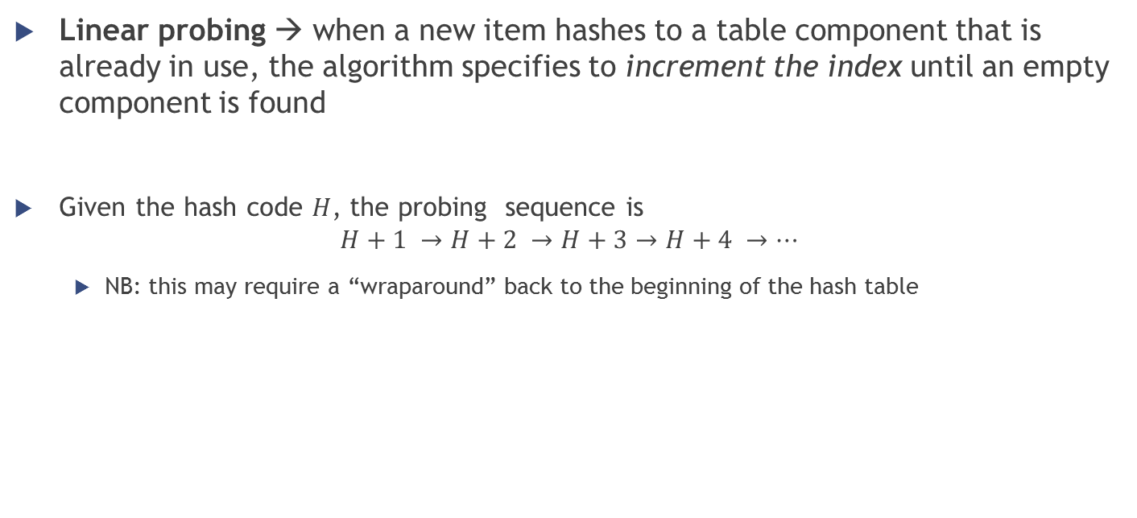
Hash table - Collision resolution with open addressing and linear probing
Linear probing → when a new item hashes to a table component that is already in use, the algorithm specifies to increment the index until an empty component is found
Given the hash code $H$, the probing sequence is
$$H+1 →H+2 →H+3→H+4 →…$$
NB: this may require a “wraparound” back to the beginning of the hash table

Slide 50
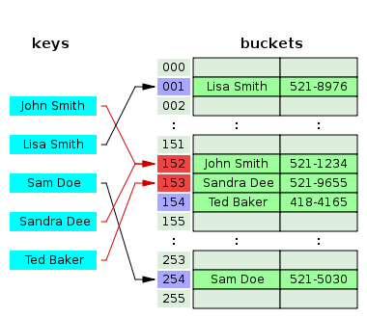
Hash table - Collision resolution with open addressing and linear probing
Linear probing examples
Tag & Rad from a few slides earlier
Sandra Dee; Ted Baker in the phonebook

Slide 51
Hash table - Collision resolution with open addressing and quadratic probing
Quadratic probing → taking the original hash index and adding successive values of an arbitrary quadratic polynomial until an open slot is found
Instead of searching linearly, it uses a squared increment
NB: this also may require a “wraparound” back to the beginning of the hash table
Given the hash code $H$, a possible quadratic probing sequence is:
$$H+1^{2} →H+2^{2} →H+3^{2}→H+4^{2} →…$$
Improved performance with respect to linear probing, but it is also more likely to result in an infinite loop…

Slide 52

Hash table - Collision resolution with open addressing
Open addressing methods drawbacks
the number of stored entries cannot exceed the number of slots in the bucket array
performance dramatically degrades when the load factor grows beyond 0.7 → dynamic resizing is mandatory
more stringent requirements on the hash function
besides distributing the keys more uniformly over the buckets, the function must also minimize the clustering of hash values that are consecutive in the probe order

Slide 53
Hash table - Collision resolution with separate chaining
Instead of resolving collisions, we can avoid them… how?
Allowing more than one item per bucket!
Method called “separate chaining” because it uses linked lists (“chains”) to hold the multiple items

Slide 54
Hash table - Collision resolution with separate chaining
Instead of resolving collisions, we can avoid them… how?
Allowing more than one item per bucket!
Method called “separate chaining” because it uses linked lists (“chains”) to hold the multiple items
In a good hash table, each bucket has zero or one entries, and sometimes two or three, but rarely more than that
Otherwise performance in hash table operations decreases because we have to add the time for the list operation

Slide 55
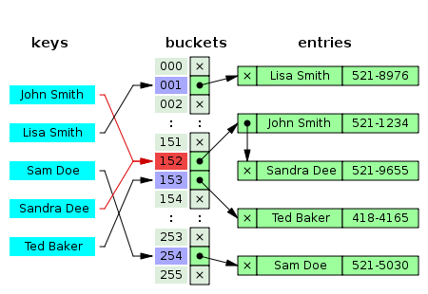
Hash table - Collision resolution with separate chaining
Example

Slide 56
Hash table - Collision resolution with separate chaining
Which data structure should we use to store the multiple items in each bucket?
Linked lists
Popular because it requires only basic data structures with simple algorithms
When storing small keys and values, the space overhead of the next pointer in each entry record can be significant
Traversing a linked list has poor cache performance, making the processor cache ineffective
Ordered lists, sorted by key field
Self-balancing search trees
Only worth the trouble and extra memory cost if long delays must be avoided at all costs (e.g. in a real-time application) or if one must guard against many entries hashed to the same slot (e.g. if one expects extremely non-uniform distributions, or in the case of web sites or other publicly accessible services, which are vulnerable to malicious key distributions in requests)
Dynamic arrays

Slide 57
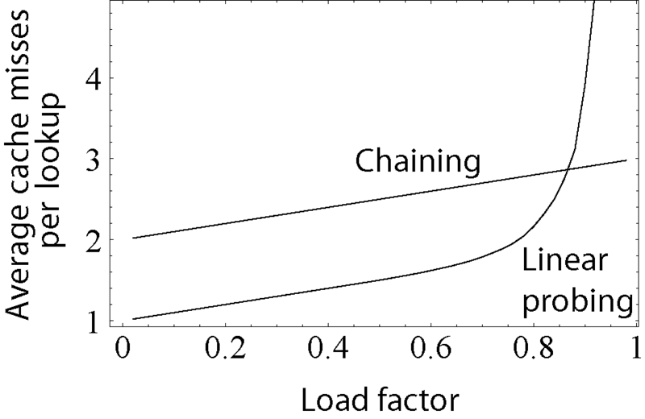
Hash table - Collision resolution
Comparison between the “performance” (seen as the average number of cache misses required to look up elements in tables) with separate chaining and linear probing
Linear probing's performance drastically degrades for load factors $>0.8$

Slide 58
Hash table – Dynamic resizing
A hash table functions well when the table size is proportional to the number of entries
Practical problem: usually the number of entries is not known in advance
Very important to provide some method to resize the table in order to prevent the hash table from becoming too full
Resizing happens only when the load factor becomes too large
In Java the default load factor threshold for table expansion is 0.75; in Python's dict 2/3
Resizing is accompanied by a full or incremental table rehash whereby existing items are mapped to new bucket locations

Slide 59
Hash table – Dynamic resizing
Resizing by copying all entries
Common approach → automatically trigger a complete resizing when the load factor exceeds some threshold
All the entries of the old table are removed and inserted into the new table
Incremental resizing
Some hash table implementations (especially real-time systems), cannot pay the price of enlarging the hash table all at once: it may interrupt time-critical operations
Keep both the old and the new table; do lookups and deletions in both tables; new insertions only in the new one; at each insertion move some elements from the old to the new table until they are all removed (and then deallocate the old table)

Slide 60
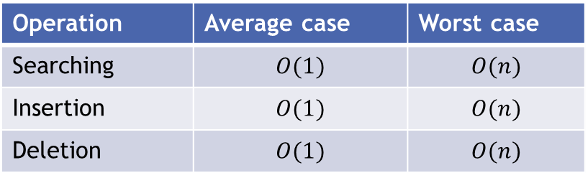
Hash table – Performance analysis
Average case
In a well-dimensioned hash table, the average cost (number of instructions) for each lookup is independent of the number of elements stored in the table
If the load factor is kept below some bound, the access functions are immediate, running in constant time → direct access, just like an array
Worst case
Worst choice of hash function → every insertion causes a collision → hash tables degenerate to linear search
Operation | Average case | Worst case
Searching | $$O(1)$$ | $$O(n)$$
Insertion | $$O(1)$$ | $$O(n)$$
Deletion | $$O(1)$$ | $$O(n)$$

Slide 61
Hash table – Pros & Cons
Main advantage
Speed → particularly efficient when the maximum number of entries can be predicted in advance (no resize)
Disadvantages
The cost of a good hash function can be significantly higher than the inner loop of the lookup algorithm for a sequential list or search tree
hash tables not effective when the number of entries is very small
Entries can be enumerated only in pseudo-random order
no efficient way to locate an entry whose key is nearest to a given key → separate sorting step needed
With dynamic resizing, an insertion or deletion operation may occasionally take time proportional to the number of entries → problem in real-time or interactive applications
Quite inefficient when there are many collisions

Slide 62
Hash table – Applications
In many situations, hash tables turn out to be more efficient than search trees or any other table lookup structure → widely used in many kinds of computer software
systems programming
primary building blocks of relational databases
associative arrays
caches
sets
…

Slide 63
Hash tables in C#
Dictionary class
Generic with respect to the types of keys and values
http://www.dotnetperls.com/dictionary
http://msdn.microsoft.com/en-us/library/xfhwa508%28v=vs.110%29.aspx
Live demo?

Slide 64
Summary
Array and Hash tables
random access data structure → each element can be accessed directly and in constant time
Linked list
sequential access data structure → each element can be accessed only in a particular order
Stack & Queue
limited access data structures (subcase of sequential data structures)
Notes:
http://www.cs.cmu.edu/~adamchik/15-121/lectures/Stacks%20and%20Queues/Stacks%20and%20Queues.html

Slide 65
That’s it
See you next week ☺

